Slide 1
JavaScript - UFO hunter game UFOs route

Slide 2
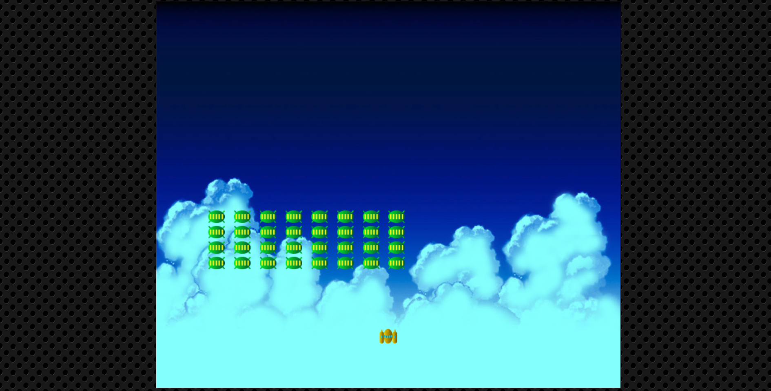
UFOS planned route
Starting point

